Slide 1
Comparing and Contrasting Networking Hardware for XYZ Corp.
By Joshua Camara

Slide 2
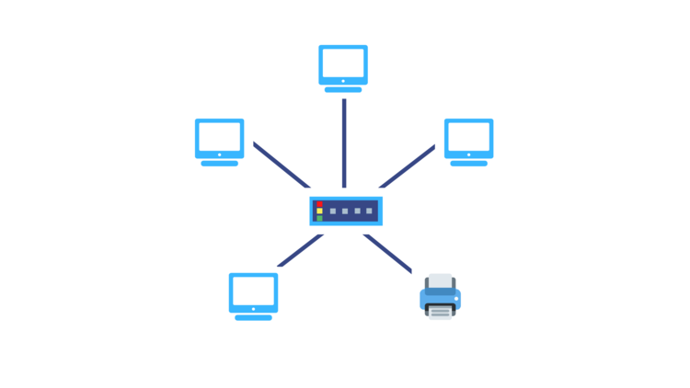
Network Design: (Peer-to-Peer)
The appropriate network architecture for XYZ Corp. should be adopting Peer-to-Peer networking. Giving employees and the company the choice to enable functionality between each other as opposed to relying on a client server in the case of a server crashing.
Resource Sharing: Peer-to-Peer allows flexibility within the start-up company to have each department customized to their specific needs for networking. Employees can share and access files with each other giving them processing power within each other.
New peers can be uploaded and removed without interrupting the servers without impact on the existing network.

Slide 3
Network Design: (Peer-to-Peer) CONT..
Cost Efficient: The main importance of selecting Peer-to-Peer gives the company a more cost efficient approach to starting and launching their enterprise.
Adopting a Peer-to-peer infrastructure will require a more hands-on approach for controlling data integrity and security within the XYZ Corp. which could be leaned on IT.
Performance can be indicated by using high-end networking hardware to provide a stable and consistent internet flow within the company.

Slide 4
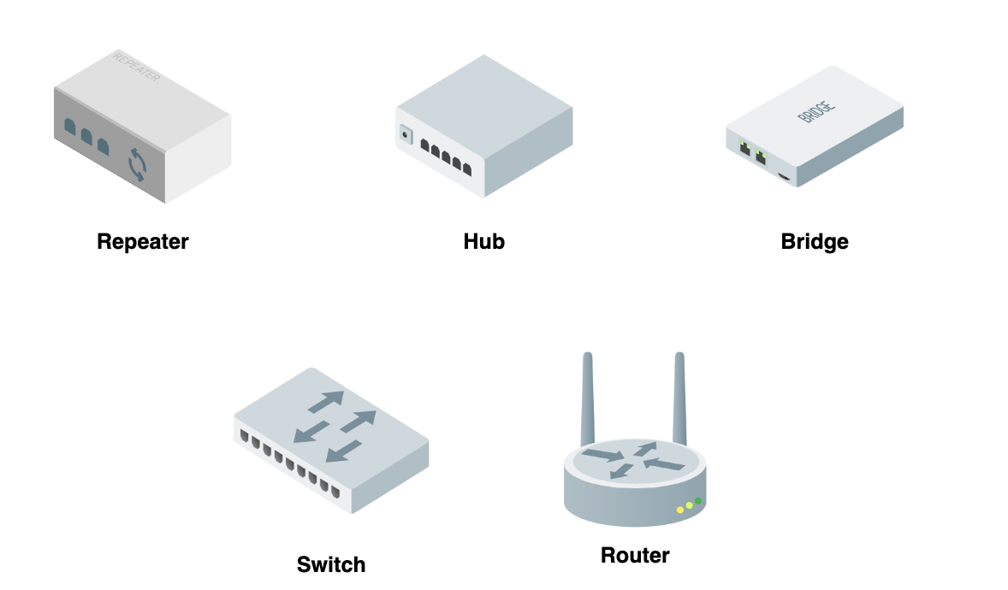
Networking Hardware: Routers
Providing XYZ. Corp with sufficient internet speeds, higher bandwidth and the appropriate networking devices purchasing the correct router is essential to wifi speeds and high-end functionality within XYZ Corp.
Asus RT-AX88U- ($249.99) . is an essential router that would be sufficient providing Dual-band Wifi 6 (802.11ax), up to 6000 mbps wireless speed and 8 Gigabit LAN ports.
Opposed to selecting the Netgear Nighthawk RAX50 ($179.99) which provides slower 4500 mbps and only 4 Gigabit Lan ports.
Providing the company with a Wifi 6 router and high-end internet speeds can ensure a user-friendly interface setup that can provide strong performance with multiple connected devices.

Slide 5
Networking Hardware: Switches
A NetGear 52-port GS752TP- ($683) provides a 52 ports of Gigabit with high port density which is compatible for P2P networking with multiple devices. The NetGear G2752TP enables PoE capability that can power phones and wireless access points which could be essential in a medium sized enterprise.
Selecting a NetGear that has only 8-10 ports would be less sufficient for the infrastructure within XYZ Corp. Deciding to choose a switch with higher port density can contribute to controlling a more faster and easier flowing internet within the company.

Slide 6

Networking Hardware: Wireless Access Point
Wireless Access points are essential for extending wireless network throughout the enterprise.
The Ubiquiti UniFi 6 Lite ($159) is Wi-Fi 6 support for faster speeds, dual-band operation up to 5 GHz and are designed for easy installation on walls or ceilings.

Slide 7
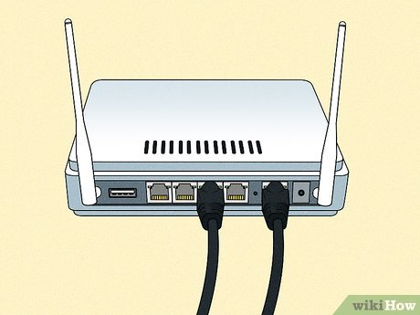
Internet Connection:
-Providing both the router and switch with Cat6a ethernet cables will providing stability of speeds up to 10 gbps up to 100 meters which is crucial for a medium-sized company looking to cover tracks across the enterprise.
- Enabling wired in connections provides to higher end speeds of internet throughout the enterprise as opposed to selecting just wireless internet connection. Using Patch Panels can help for efficient cable management.
-The benefit of the NetGear GS752TP is it supports 2 SFP ports for faster fiber connections with gigabit ports that can also be compatible with a wide range of cables such as Cat5e, Cat6, or Cat6a cables.

Slide 8
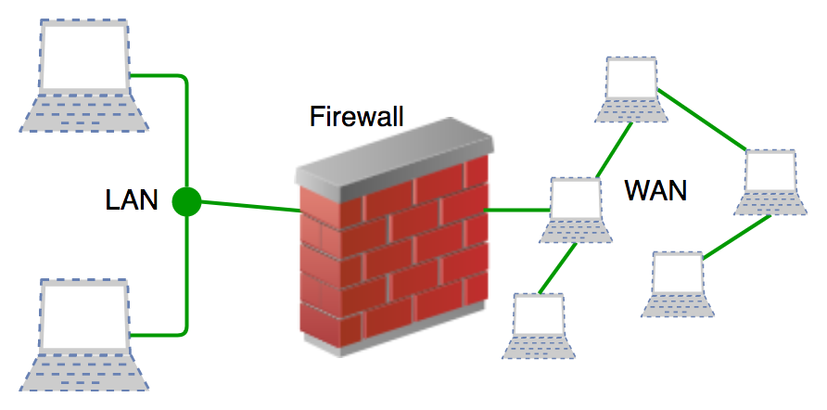
Security and Segmentation:
-Selecting Firewall solutions such as Fortinet Fortigate secures networking and sensitive data with an integrated Intrusion Preventions System provided with anti-malware protection perfect for a medium sized toi larger network. This solution provides comprehensive security features protecting against a variety of threats.
- A VPN solution could be leaning towards using Nordlayer that is an easy to use user-friendly interface with cross-platform support that has dedicated IP addresses and access control. Strong encryption and security features.
-Implementing these security solutions will provide a solid foundation for data integrity within XYZ Corp. ensuring for a secure network infrastructure within this medium sized enterprise.

Slide 9

Future Growth and Possibilities
-Scaling the company within the future could consist on a switch to Client to Server Architecture based on a rise in employees.
-Considering Metropolitan Area Networks and Wide Area Networks can vary on the global and national expansion of the company.
Conclusion: Selecting P2P networking gives a more scalable approach to starting the company and creating a more relaxed and user-friendly networking environment. Providing the essential IT support and security measurements can help to instill a positive and cultivating working enterprise.

